Slide 1
CF Obesity data – initial look

Slide 2
Data overview
Data on 9,266 people, annually from 2007-2023. over 100k rows overall
Birthdates are between 1927 and 2005
Youngest person in the 2007 reviews is 2 years old. Youngest person in the 2023 reviews is 18 years old
The proportion of children decreases over time. In 2007 50% are under 18, by 2023 only 3% are under 18
Large proportion missing BMI percentiles (100% missing for 2016 & 2017). Children’s weight groups are based on BMI percentile, so can’t be calculated
Most years have BMI or height & weight though, are there lookup tables to get percentiles?
2016 & 2017 just have height percentile and weight percentile, which can’t be used to calculate BMI percentile
Don’t have the date of the annual reviews. Makes it difficult to calculate which treatment people are on
Other variables: age, sex, ethnicity, mutation, FEV1%, number of IV days (home & hospital), supplemental feeding by route (oral, nasogastric, gastronomy, jejunal, parenteral), microbiology (did the patient grow Pseudomonas, Bcenocepacia, Staph.aureus, Aspergillius), is the patient taking pancreatic enzyme supplements, CMPL NTM, employment status (2016 onwards), CFTR history, transplant history (liver, lung, kidney, pancreas)

Slide 3
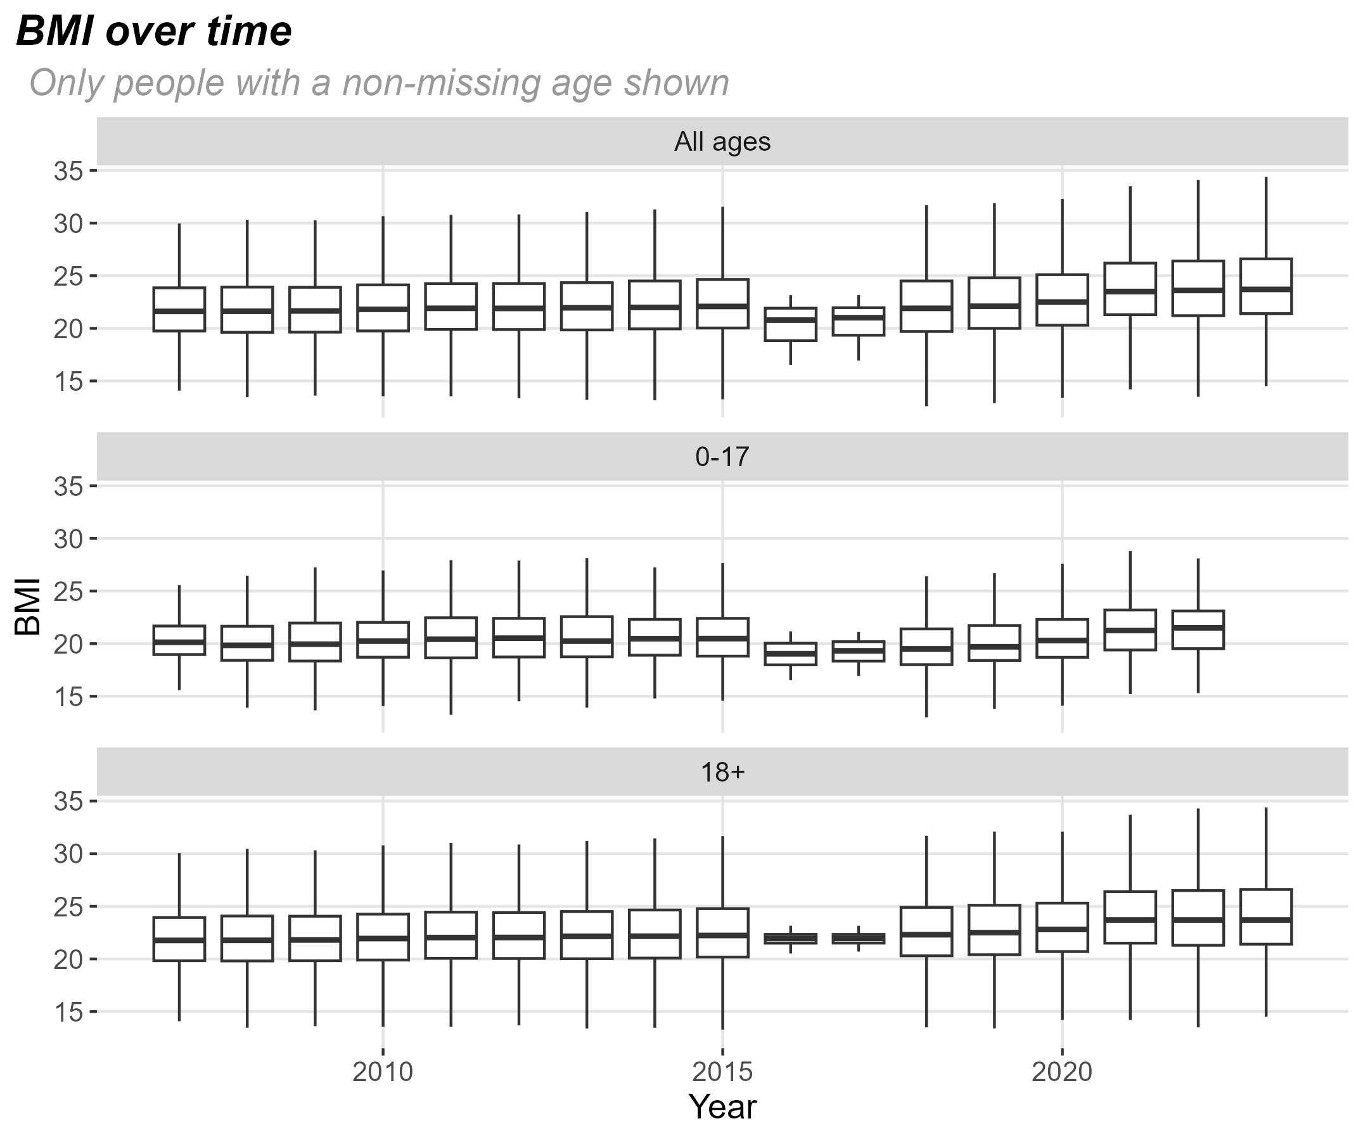
BMI trends
For each year the thick line is the median BMI, 50% of the data is between the upper & lower lines of the box, and roughly 95% of the data is between the whiskers
BMI has gradually increased since 2018. The increase has happened in both adults & children

Slide 4
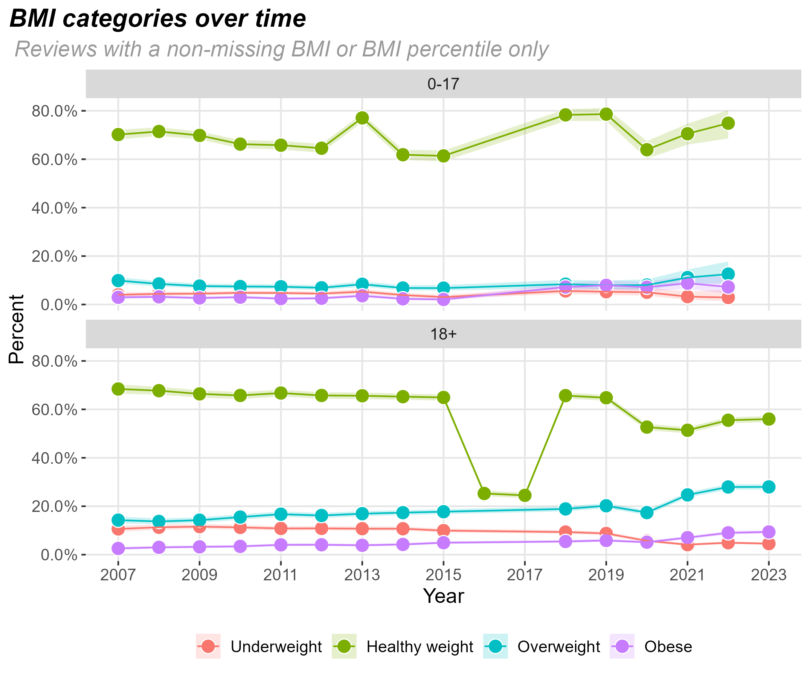
BMI groups – by age
Each point is the proportion of people in each weight group, the lighter line shows the uncertainty around the estimate. The more people in the group, the smaller the uncertainty
Adults have seen large increases in the proportion who are overweight or obese. There are also increases in children, but these are much smaller

Slide 5
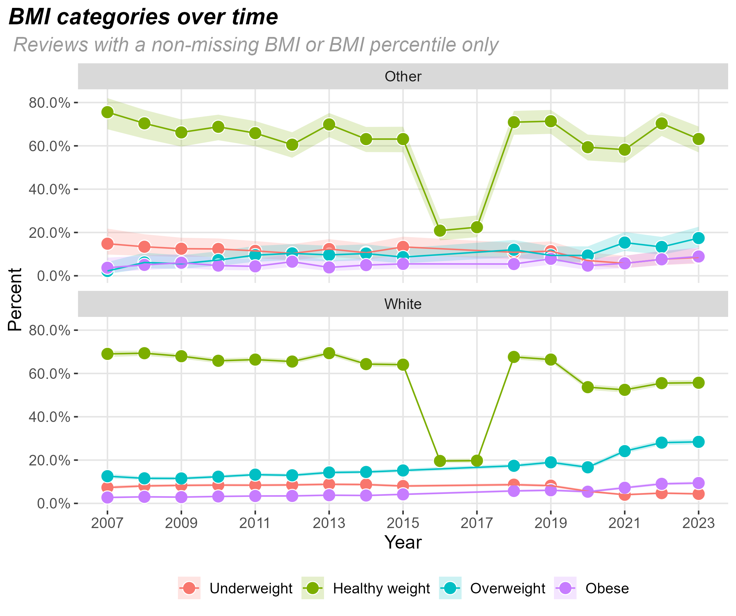
BMI groups – by ethnicity
The data has detailed ethnicity (e.g. mixed, white-British, black-Other etc) but the numbers are too small to get good estimates
Similar trends by ethnicity

Slide 6
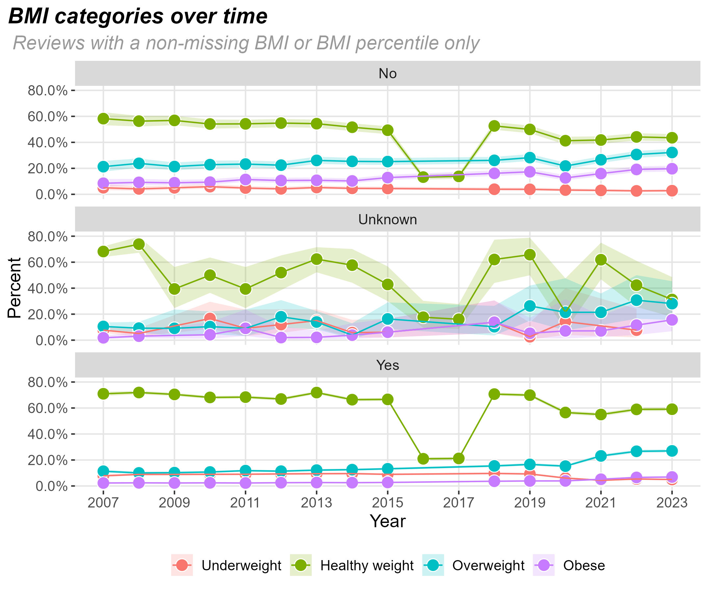
BMI groups – by pancreas supplement
People receiving pancreas supplements have a much smaller increase in the proportion who are obese compared to people not receiving supplements

Slide 7
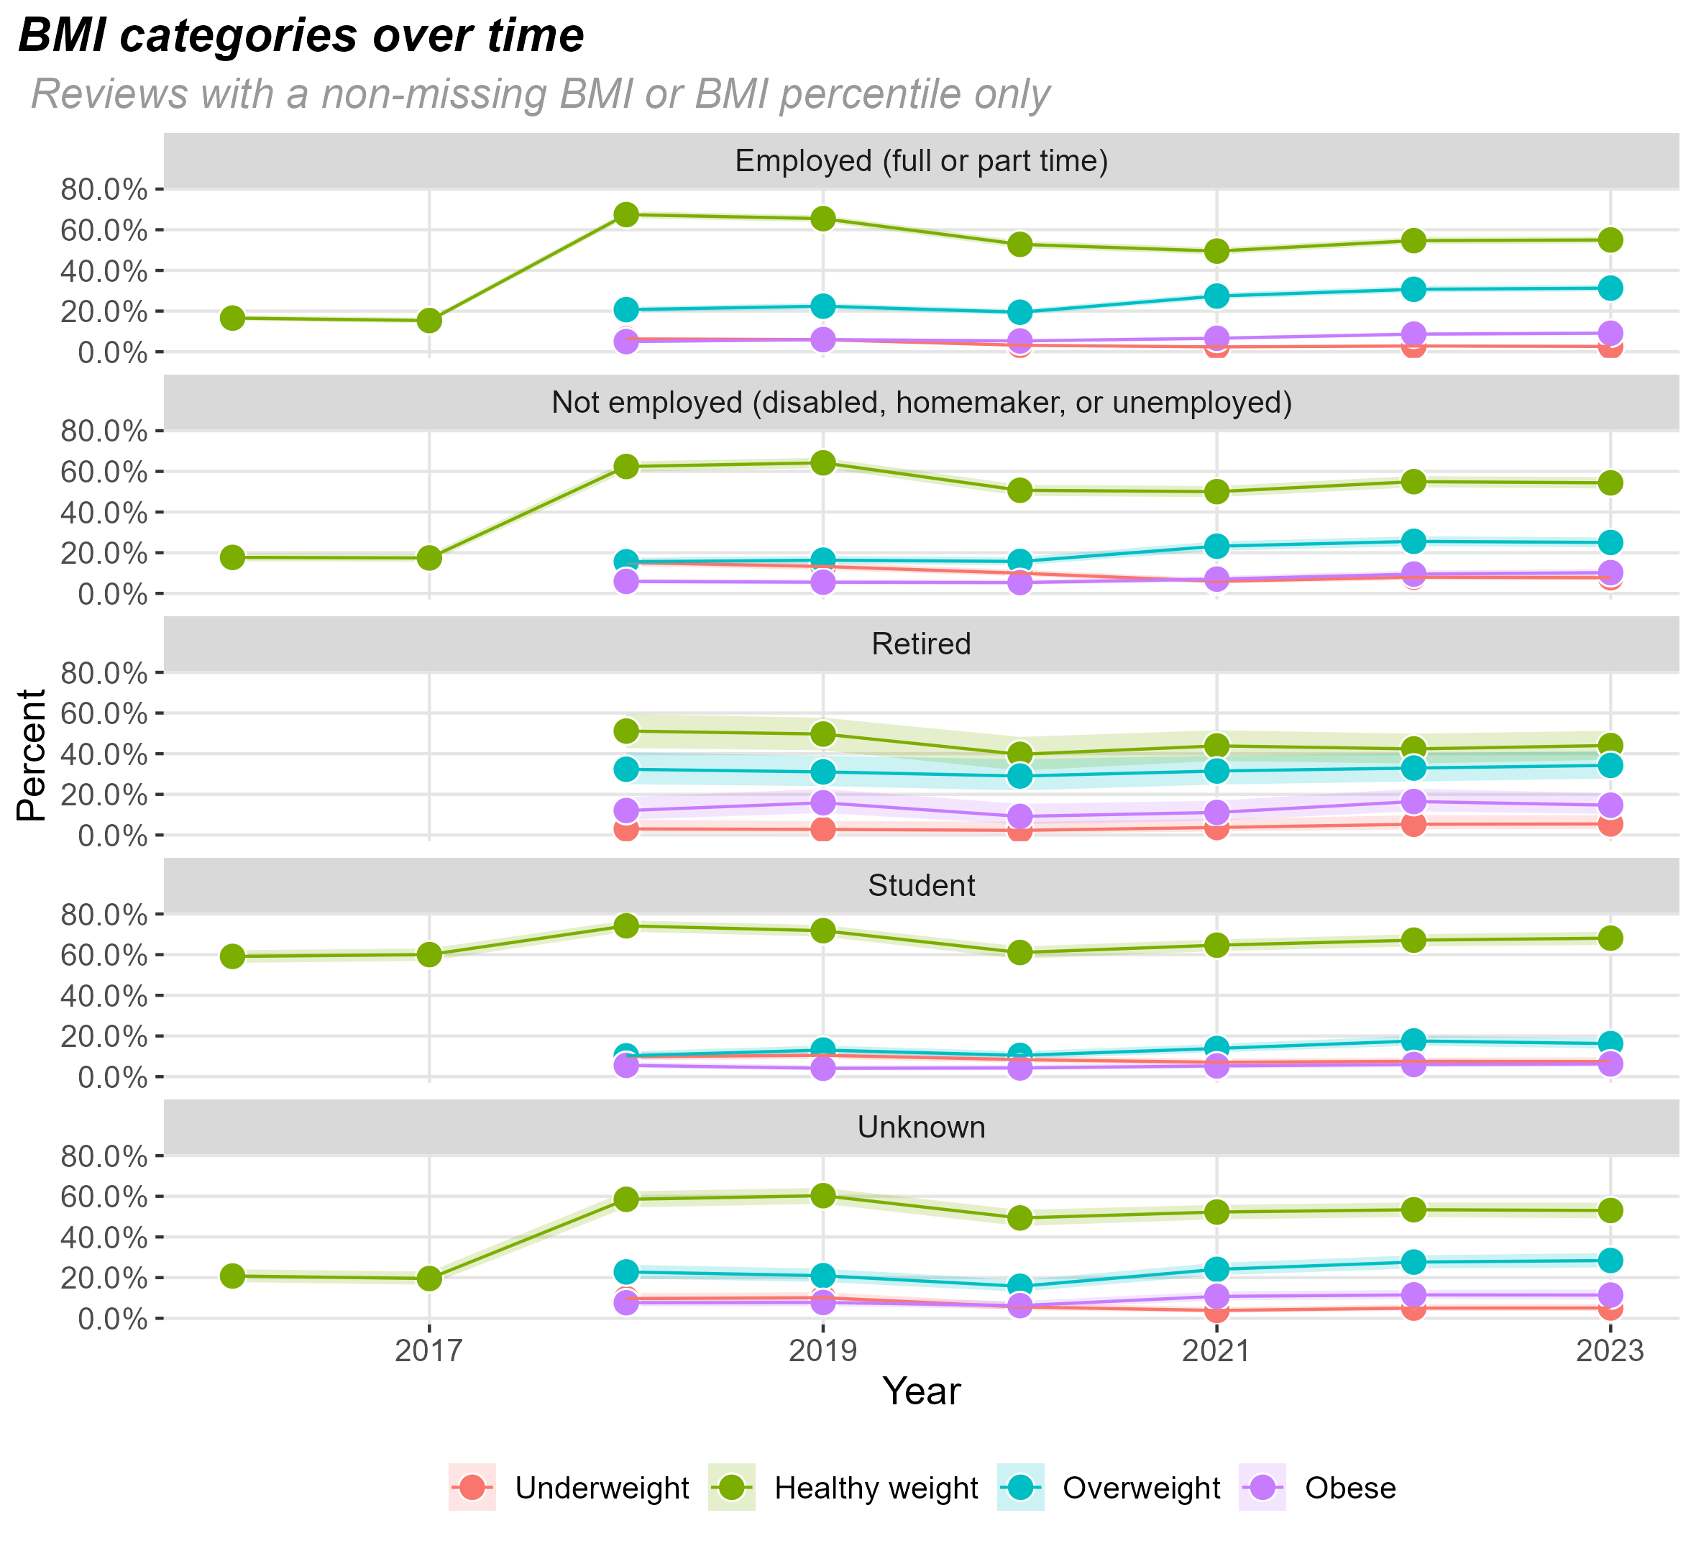
BMI groups – by employment status
Similar trends by employment status
Retired group has the lowest proportion at healthy weight & students have the highest proportion, most likely due to age

Slide 8
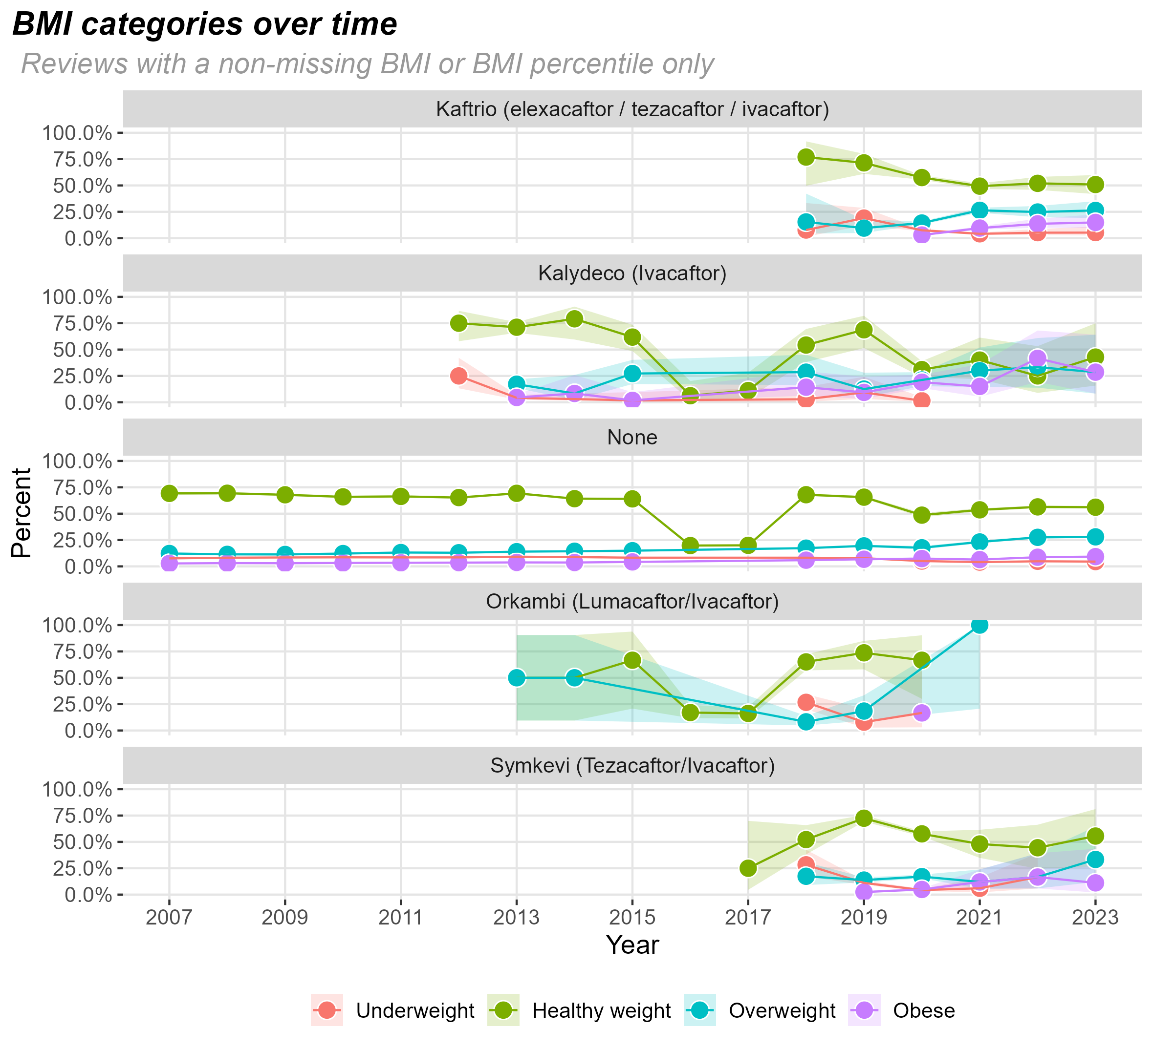
BMI groups – by treatment
Similar trends across all the treatment types. Some (Orkambi) have had large increases in the overweight proportion, but there are small numbers of people on this treatment
Note: Since we don’t have check-up date, people have been assigned to a treatment based on the treatment they were on at the start of the year. If a person is on multiple treatments in 1 year, they are assigned to the treatment they are on the longest
People can move treatments – e.g. someone could be on Kalydeco in 2015 then Kaftrio in 2019. Could also look at time on treatment if we had the check-up dates

Slide 9
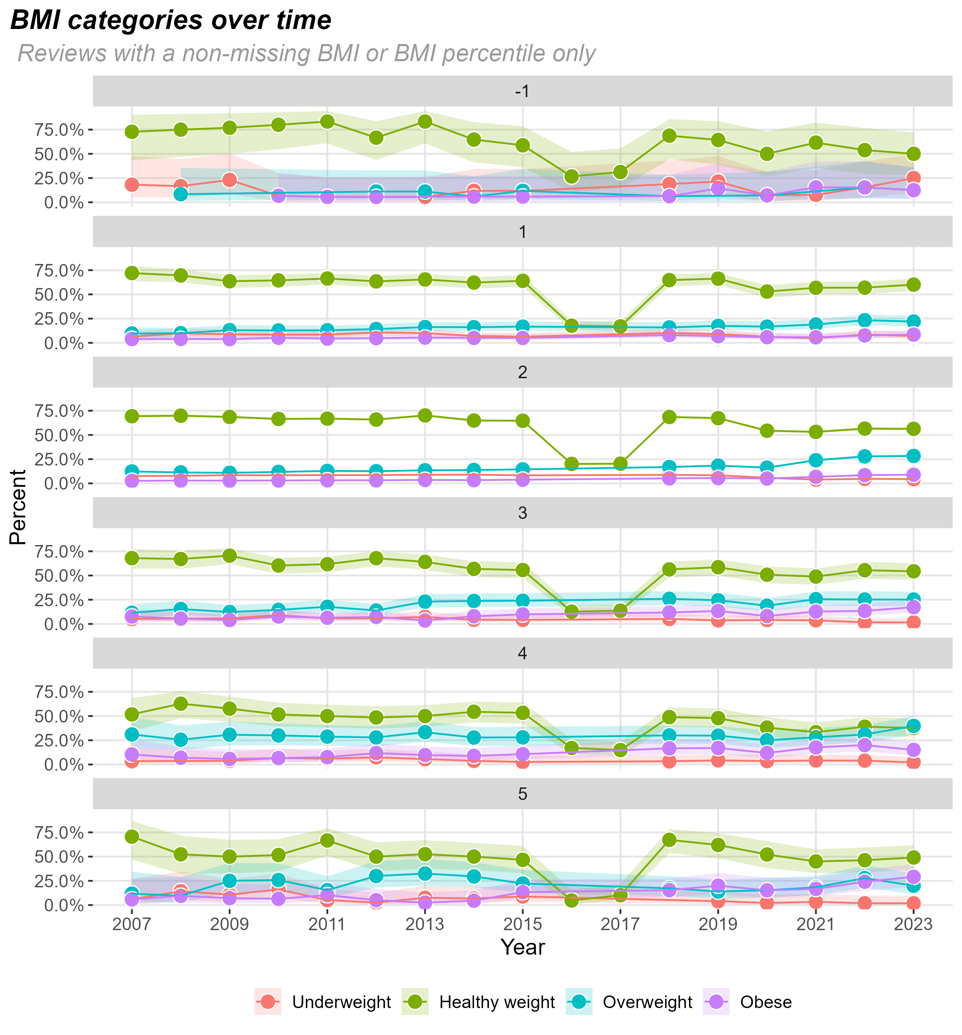
BMI groups – by mutation group
All mutation groups show a drop in the proportion who are healthy weight from ~2018

Slide 10
Data questions / requests
Things to check with the CF group:
Is the data for 2016 & 2017 correct?
Can we get BMI percentiles for 2016 & 2017?
Can we get appointment date instead of year?
Is there a standard way to group mutations?
Other stuff:
Are there lookups to convert BMI to BMI percentile?
Is employment status a good enough proxy for socioeconomic status?
How should the IV days (continuous), supplemental feeding (binary yes/no for the different feeding methods), and microbiology (binary yes/no, some also have a binary yes/no if the infection is chronic or intermittent) variables be used?

